Slide 1
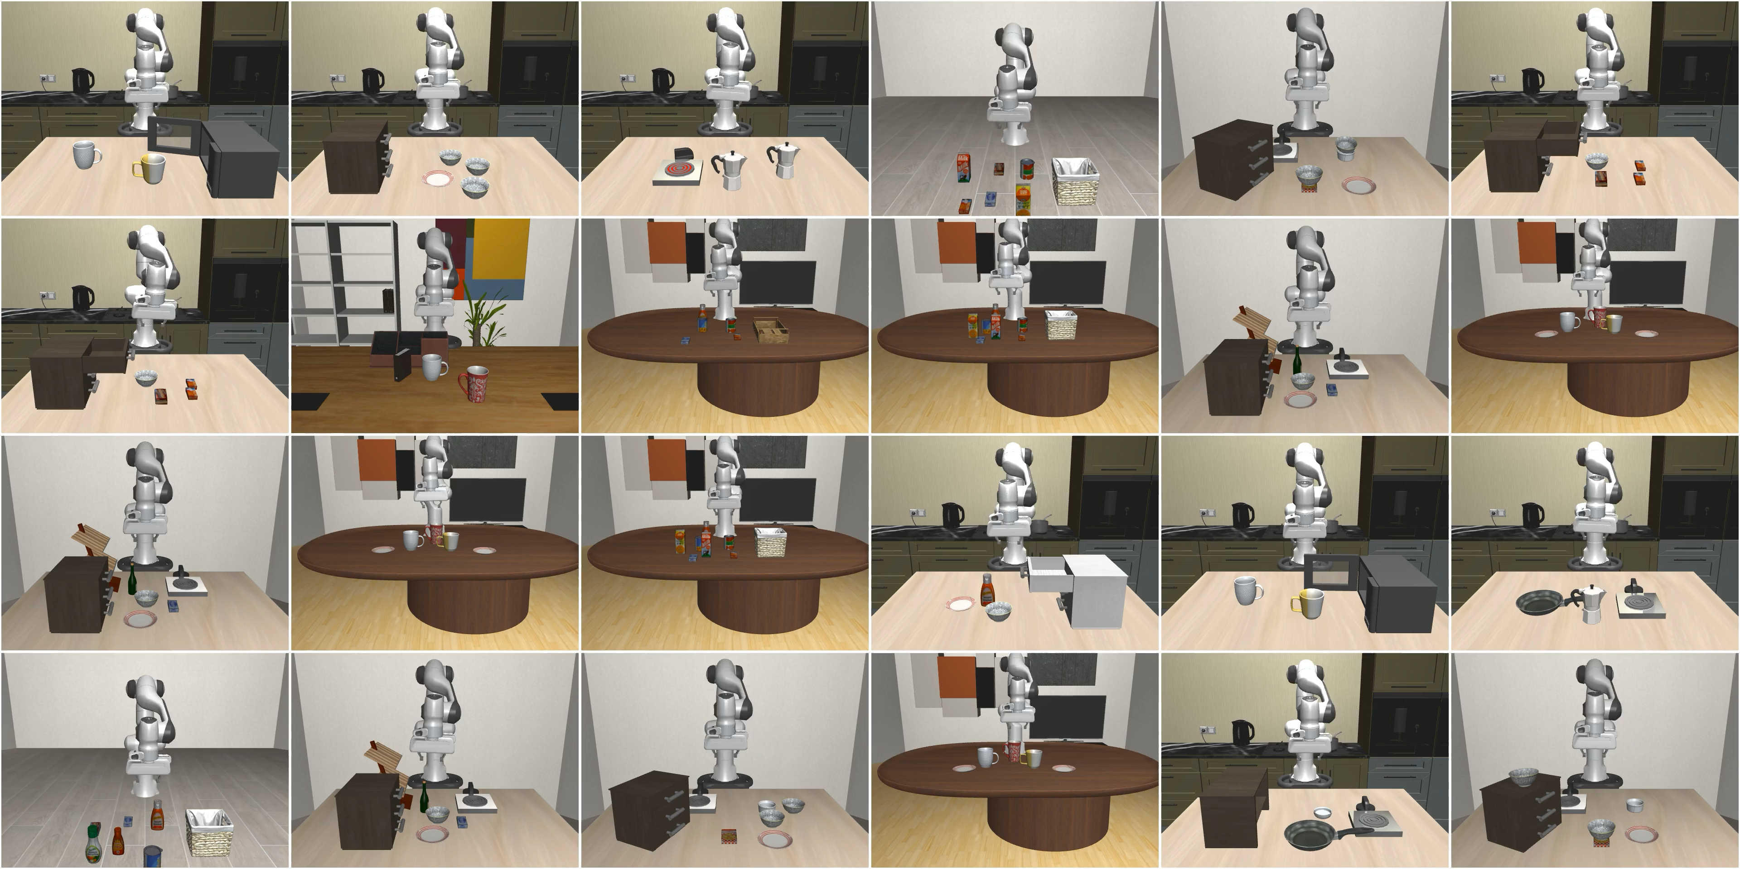
LIBERO: A Benchmark for Lifelong Robot Learning

Slide 2


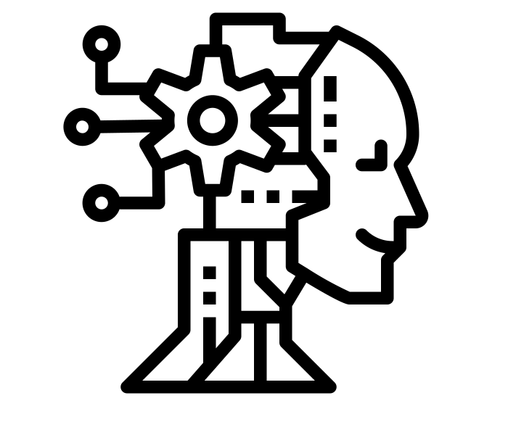

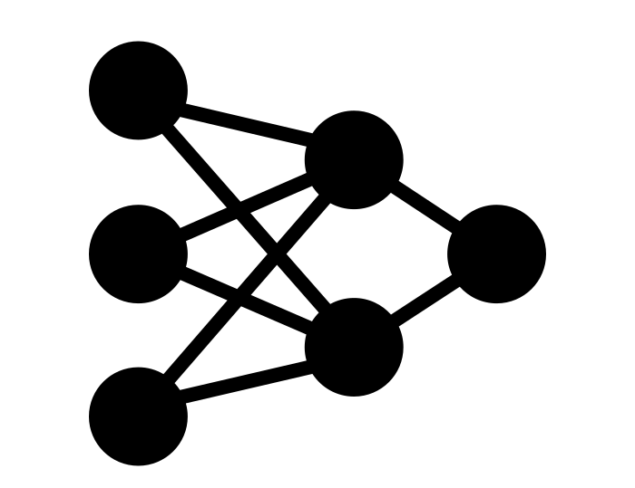


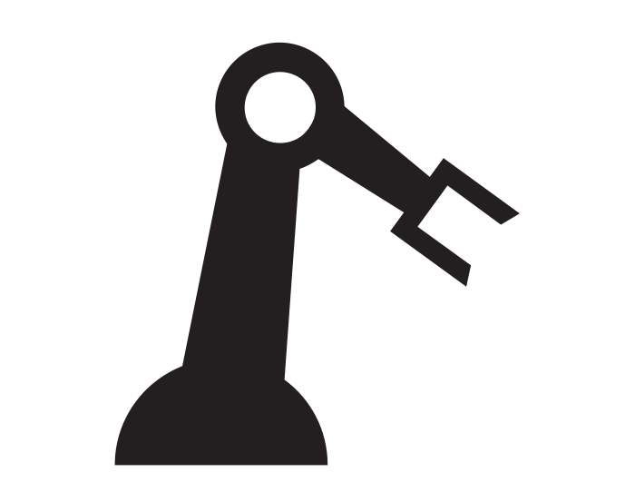



LIBERO Covers Five Main Research Topics
Distribution Shift
Algorithms
Neural Architectures
Task t
Task t+1
Task Ordering
Pretraining Effect
Pretrained Policy
Notes:
VIOLA is able to solve tasks that are better than state-of-the-art BC baselines BC-RNN (Maybe show the figure?)

Slide 3
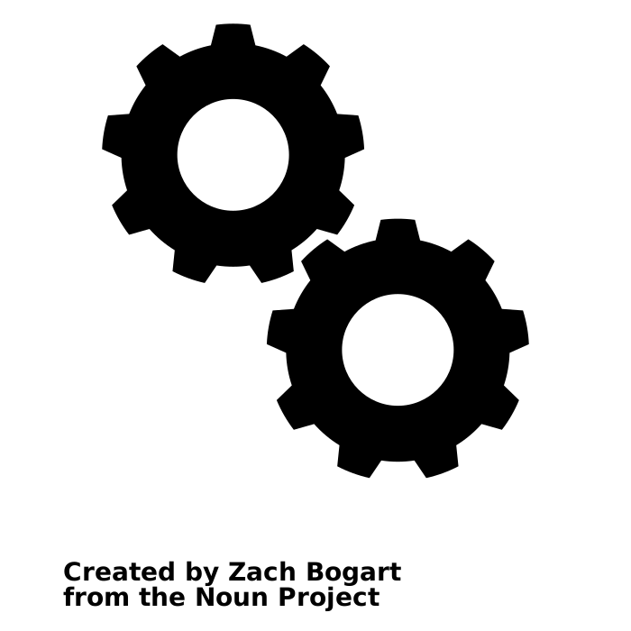

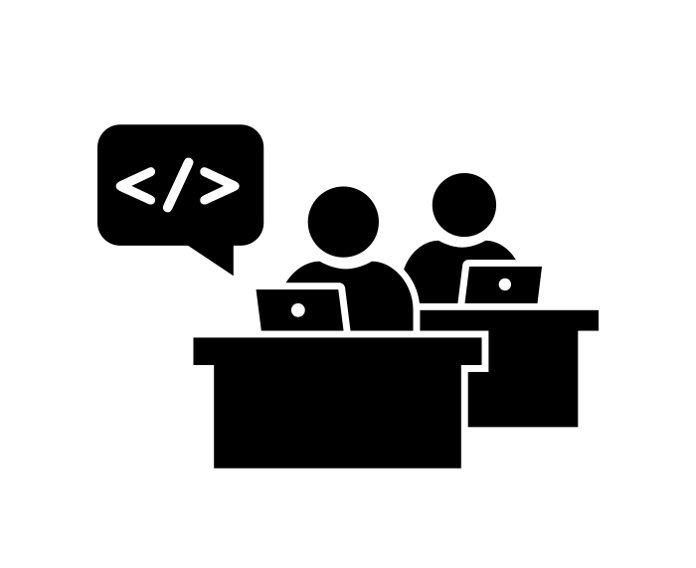
Robosuite-Based Task Procedural Generation
Procedural Generation
Specify Init Configuration
(:init
(On cabinet_1 cabinet_region) (On plate_1 plate_init_region) (On bowl_1 bowl_init_region) )
Specify Task Goals
(:goal (and
(Open cabinet_1_top_drawer)
(In bowl_1 cabinet_1_top_drawer)
)
)

Slide 4
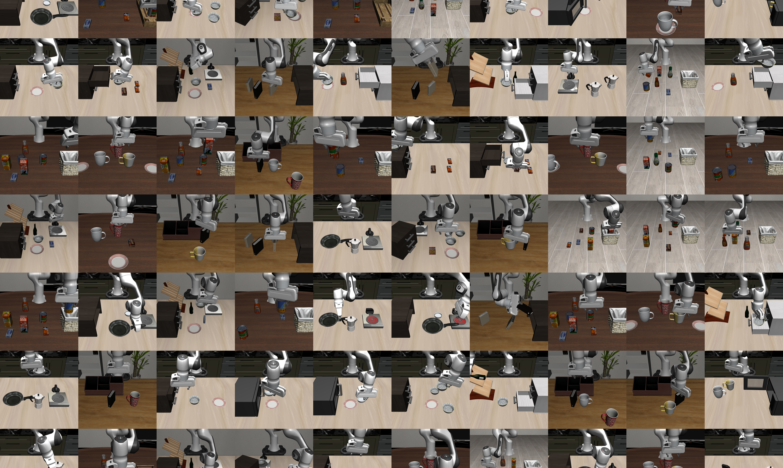
Robosuite-Based Task Procedural Generation
Procedural Generation
Specify Init Configuration
(:init
(On cabinet_1 cabinet_region) (On plate_1 plate_init_region) (On bowl_1 bowl_init_region) )
Specify Task Goals
(:goal (and
(Open cabinet_1_top_drawer)
(In bowl_1 cabinet_1_top_drawer)
)
)
Number of tasks that can go to ∞

Slide 5
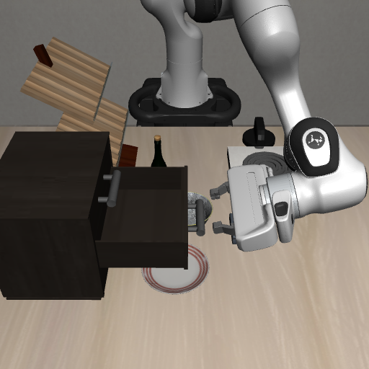
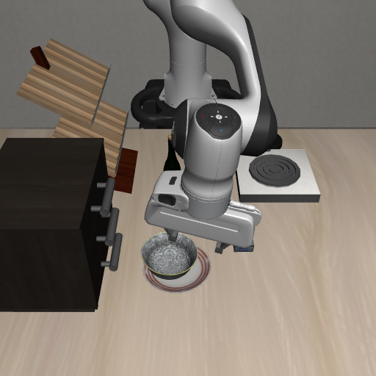
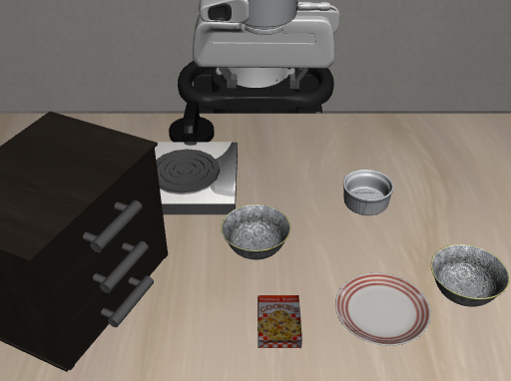
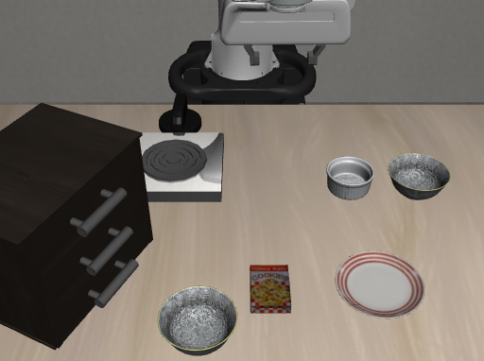
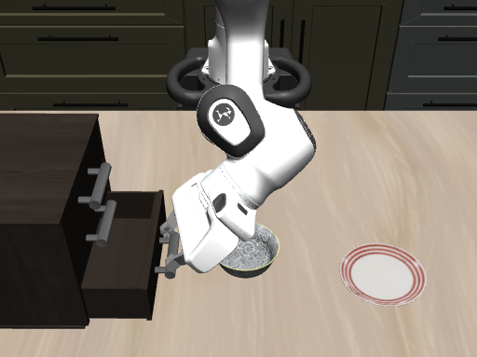
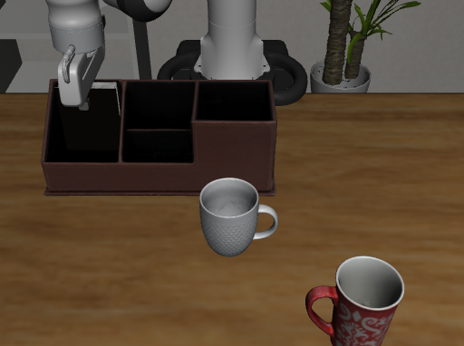
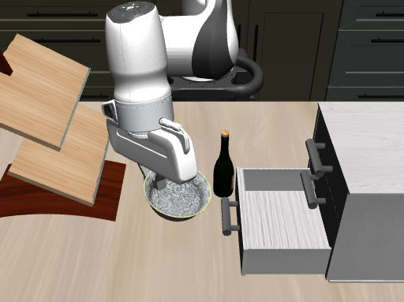
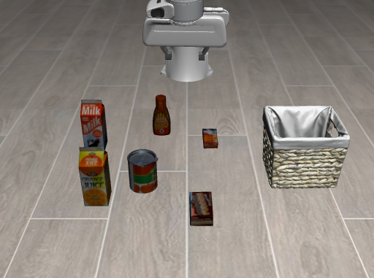
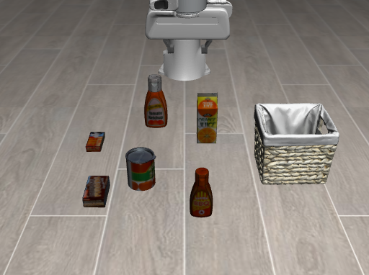
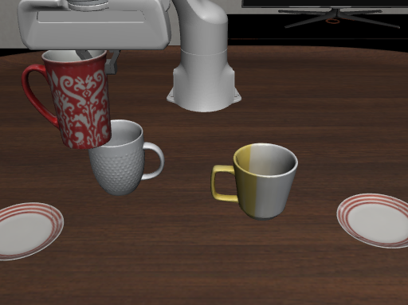
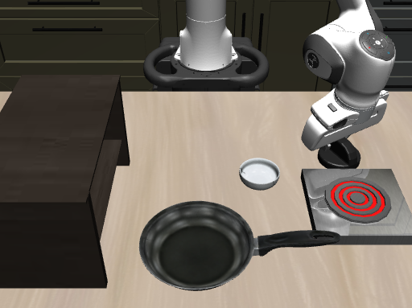
LIBERO offers …
Four task suites for disentangled and entangled knowledge transfer
LIBERO-Goal
LIBERO-Spatial
Same layout and objects, different goals
Same objects , different spatial layouts
LIBERO-100
LIBERO-Object
Same spatial layout, different objects

Slide 6

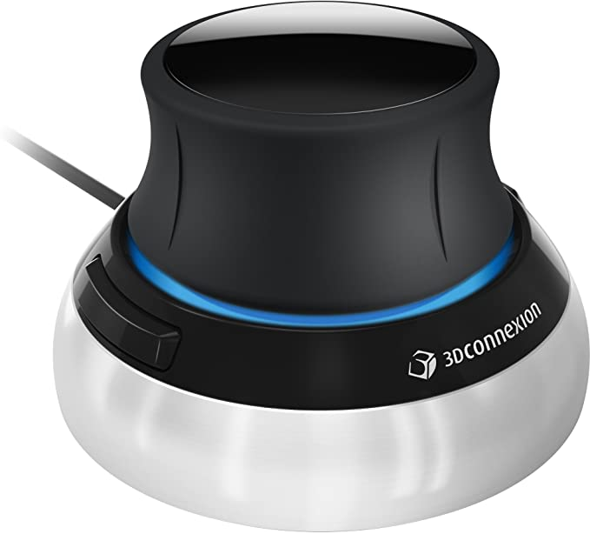


And …
High-quality teleoperation demonstrations
memory
buffer
penalty
Three representative lifelong learning algos
Memory
(Experience Replay)
Regularization
(Elastic Weight Consolidation)
Dynamic Architecture
(PackNet)
Three popular visuomotor policy architectures

Slide 7
Welcome!

